Slide 1
Notebooks and Recipes in Data Science Workspace
Chetan Kumar Bhatt, Pankil Doshi, Sathya Arun

Slide 2
Use case: Predict Retail Sales
The data for our use case is ingested on Adobe Experience Platform We’ll learn to create a Machine Learning model to predict sales for a retail store using Data Science Workspace

Slide 3
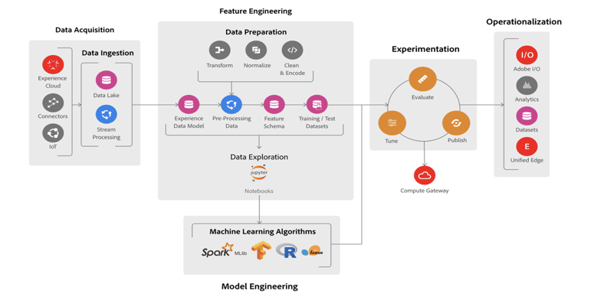
Data Science Workspace

Slide 4
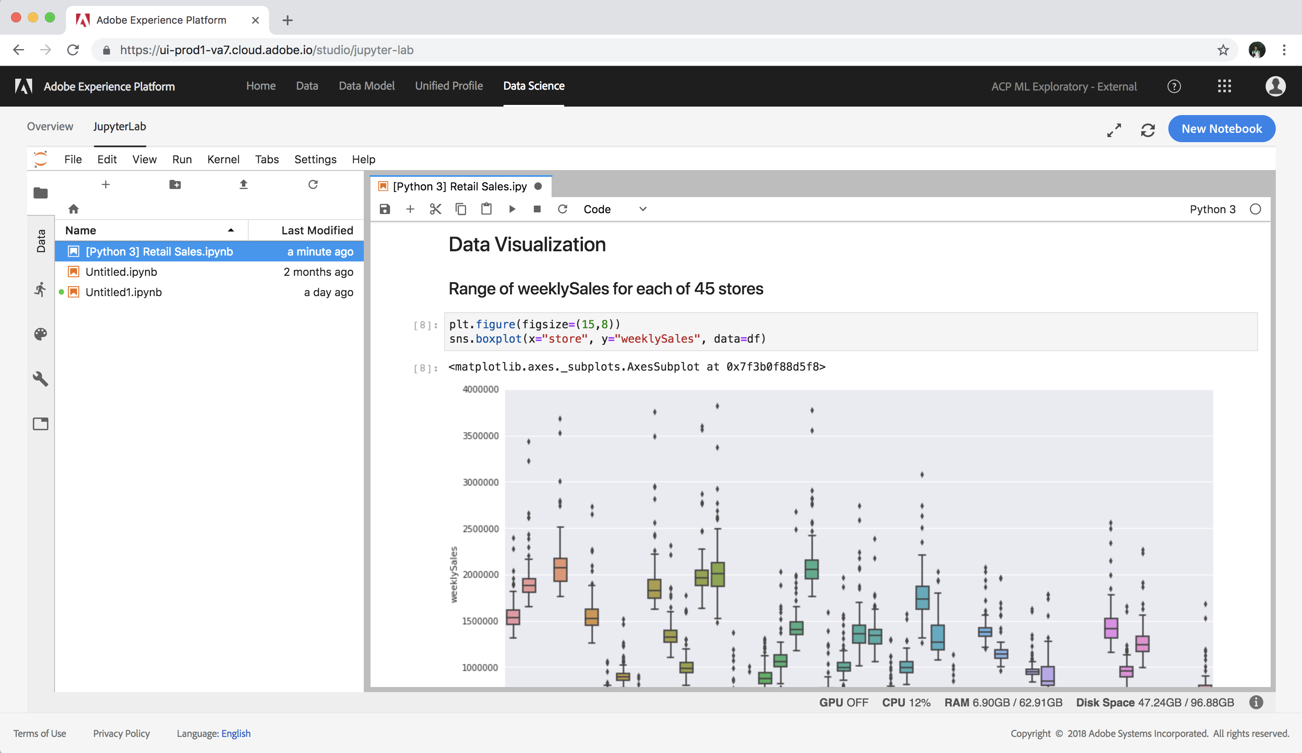
Notebooks
The Data Science Workspace allows Data Scientists to create Jupyter Notebooks through the JupyterLab platform where they can create and edit machine learning workflows.
Capabilities
Data Exploration
Data Visualization
Model Prototyping
Model Training
Model Scoring
Access Platform Data
Python, R & Scala Support
Integration with Spark
Schedulable Notebooks
GPU Support
Includes Popular Libs

Slide 5
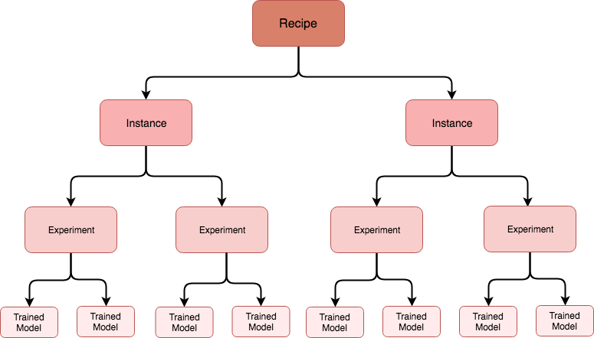
Recipes
A Recipe refers to a proprietary algorithm, or an ensemble of algorithms, to help solve specific business problems.
Capabilities
XDM compatible
Platform data access support
Support for Spark, PySpark, Python, Tensorflow & R
Configuration management
Model evaluation
Ability to schedule experiment runs
Preserves model lineage
GPU support
Feature pipeline
Real time scoring on edge

Slide 6
Lab Agenda
Explore data for the lab (~10 mins)
Import pre-built notebook, run it, tweak it, hack it (~15 mins)
Build recipe, train it, evaluate it, score it (~15 mins)
Q/A (~10 mins)
Contact : #dsw-users
https://git.corp.adobe.com/ml/ts-2019

Slide 7
Lab Ride
Volunteers
Sayash Kumar
Arunkumar Puppala
Arun Kalyaanasundaram
Vijeth Lomada
Tatsuya Ishii

Slide 8
Lab Details
https://git.corp.adobe.com/ml/ts-2019 (VPN)
https://platform.adobe.com
dswlabs+user<<ROW_NUMBER>>@gmail.com
Techsummit19

Slide 9
What all you achieved
Explored data within platform.
Imported notebook, explored features, build various models, picked the best performing model.
Packaged best performing model as recipe and went through lifecycle of training, evaluating and scoring.
Good job everyone!!

